Slide 1
Food to go: a future focus
Katie Gallagher, 5 March 2024

Slide 2
Five key trends shaping food to go
Growth expectations
Partnerships
Nuanced healthier eating
Multiple formats
Digital innovation
Sustainability

Slide 3
Easing tailwinds call for cautious optimism
Source: EY Item Club Winter Forecast, January 2024
Notes:
The economy is forecast to return to more ‘normal’ historical levels of growth by the end of 2024F.
Risks to the outlook include volatile geopolitics, interest rates and persistent inflation if low unemployment continues to lead to higher wages.
More normal economic activity from 2024 onwards will benefit the food to go market and support business investments in the market.

Slide 4
Food to go market growth is forecast to accelerate from 2024F-2027F
UK food to go market value in billions, with percentage growth, 2023-2027F
2016-2019 | 2019-2024F | 2024F-2027F
+2.7% | +1.8% | +2.8%
Source: Lumina Intelligence Market Sizing Insight & Analysis, January 2024
Notes:
A return to more ‘normal’ levels of growth in the economy will support a strengthening food to go market.
Key factors impacting the food to go market including tourism and travel are set to see a boost following the pandemic and the subsequent period of economic fallout.
Employment rates are expected to remain at record highs contributing to consumer demand for on-the-go meal and drink solutions.
Food to go specialist channels including sandwich & bakery, coffee shops and contemporary fast food and expected to achieve the strongest percentage growth rates.

Slide 5
Trends expected to be at the centre of operator growth strategies
Nuanced healthier eating including focus on gut health, protein and nutrient dense foods will influence NPD in food and beverages
Digital innovation aligned with artificial intelligence will mitigate staff shortages and drive operational efficiencies
Partnerships between brands and suppliers across FMCG and foodservice will explore limited time offers and boost engagement
Multiple formats will capitalise on investment in forecourts, railway stations and airports as operators leverage flexibility
Sustainability will be front of mind for operators in packaging and supply chain developments
Source: Lumina Intelligence, February 2024

Slide 6
Healthier habits focus on functional drinks and macronutrients
44%
of FTG consumers
very health conscious
+2ppts vs OOH
Source: Lumina Intelligence Eating & Drinking Out Panel 52WE 31/12/2023
Notes:
Recent pandemic-induced changes have fuelled the growth of health and wellness trends, prompting increased consumer mindfulness around dietary choices and government initiatives aimed at improving national health.
LEON has introduced a plant variety rating system that uses menu symbols to encourage consumers to up their plant intake and guide them toward a more diverse and nutrient-dense dish.
This coincides with the launch of its new Veganuary menu for 2024 that aligns with growing gut health focused wellness trends.

Slide 7
FTG brands are harnessing the power of plants to tap into health-led trends
Source: Lumina Intelligence Eating & Drinking Out Panel 52WE 31/12/2023
Notes:
Chipotle has launched a new menu featuring nourishing lifestyle bowls designed to cater to contemporary wellness trends.
The brand aims to make sustaining healthy habits convenient for consumers, offering dishes compatible with a variety of lifestyles including vegan, vegetarian, high protein, gluten-free, and grain-free.

Slide 8
Health and wellness trends a key influence on NPD in the market
N/A
Source: Lumina Intelligence, February 2024

Slide 9
Functional drink ranges are expanding across the market
Source: M&S, The Grocer, February 2024
Notes:
M&S recently partnered with science-based nutrition pioneers ZOE to launch a milk-based gut health shot.
This follows increasing consumer awareness around the gut’s role in overall health, with the brand stating that searches for ‘gut health’ were up +247% on Ocado since 2021.
This collaboration sees M&S at the forefront of gut health innovation, aligning itself with growing wellness trends. In addition, M&S has launched a range of good gut products including cereals, yogurts and drinks.

Slide 10
Digital innovation is essential to deliver on customer demand
Food to go occasions: reason for choosing an establishment (Top 10)
Source: Lumina Intelligence Eating and Drinking Out Panel, data collected 52WE 22.01.2023 and 21.01.2024

Slide 11
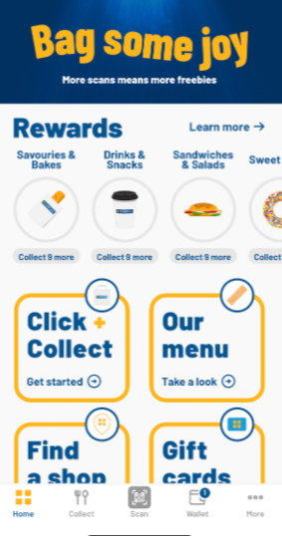
Meal deals are achieving trade up in the food to go market
Food to go market: food or drinks consumed
Source: Lumina Intelligence Eating and Drinking Out Panel, data collected 52WE 22.01.2023 and 21.01.2024
Notes:
Value for money and voucher/promotions/loyalty cards
Digital loyalty is more and more important

Slide 12
Digitalisation will drive fast service credentials
Source: MCA, Knoops, Costa Coffee, Subway, Lumina Intelligence, February 2024
Notes:
Brands utilise digitalisation to align with on-the-go consumer needs
Costa is using digitalisation to enhance the customer experience, opening its first site featuring touch screen ordering systems to streamline operations. Other features include a collection point for customers on-the-go and a new mobile order-to-table feature with QR code scannable on the Costa Club app.
Knoops launched a next generation app that enables customers to tailor and pre-order their favourite bespoke chocolate drinks. The app enhances the customer journey, supporting the brand in growing its multi-channel offering, extending its market reach.
Subway looks to enhance the digital experience by introducing self-order kiosks to UK sites for the first time as part of its digital transformation strategy. The new features aim to modernise the brand and help compete with QSR giants.

Slide 13
Artificial intelligence will drive digitalisation in the coming years
Source: Lumina Intelligence, February 2024, picture examples from payment software Sunday and staff scheduling software rotageek
Notes:
For front of house it means:
Social media content and copy creation to target specific customer types
Personalisation of the customer experience through online ordering and digital marketing
Self-serve technology including kiosk-digital ordering platforms and digital payment or split bill technology.
For back of house:
Integrated inventory and purchasing through software allowing historical inventory and purchasing data to reveal trends and make recommendations for current purchasing needs.
Artificial intelligence-enabled software tracking staffing and sales data to determine trends and patterns so that staff can be allocated as needed.

Slide 14
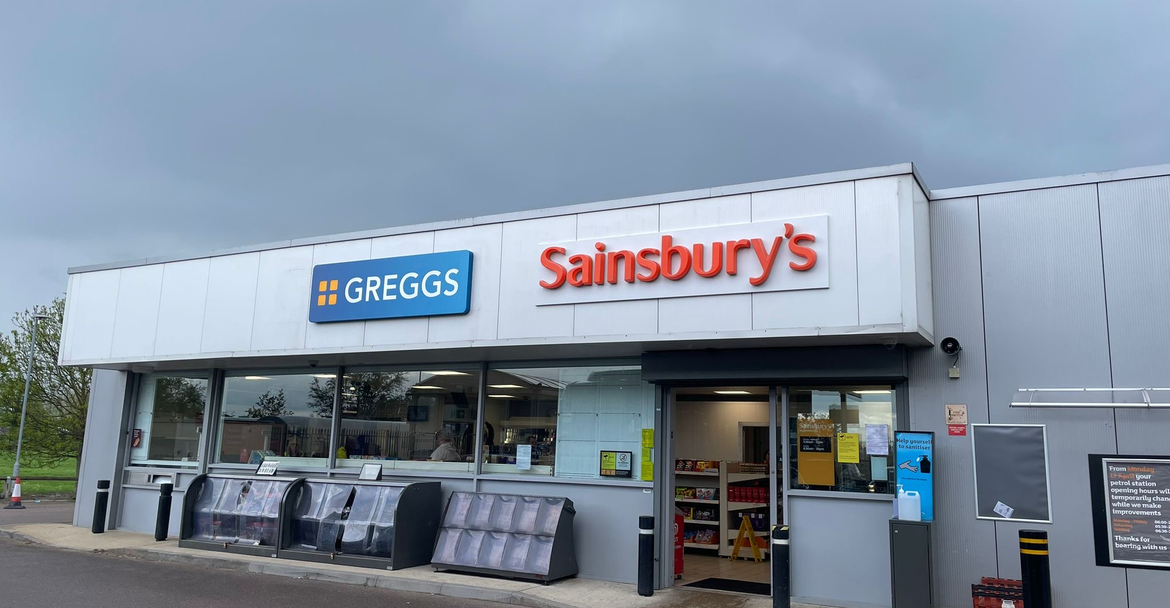
Convenience store grab and go is set to add the most value
Top 10 food to go channels ranked by absolute growth in millions, 2024F-2027F
£2.0 bn
Source: Lumina Intelligence Market Sizing Insight & Analysis, January 2024
Notes:
Convenience store grab and go has achieved strong food to go growth versus pre-covid, driven by investment in ranges and value.
The introduction of tiered meal deal ranges has allowed grocery operators to avoid hiking costs of meal deals whilst introducing more premium and foodservice-standard ranges.
Convenience store grab & go is forecast to lead absolute value growth for the food to go market.
Operators including Sainsbury’s and M&S have stressed the importance of food on the go in strategy reviews for the next few years.
Greggs is expected to play a key role in sandwich & bakery channel growth, pushing forwards with ambitious growth plans including new distribution centres and food innovation.
Greggs is accelerating its partnership with Sainsbury’s, opening its first standalone café within a supermarket.
This follows on from the Greggs concessions launched in Sainsburys forecourts which proved popular among consumers. The partnership helps the brand to diversify its retail estate and extend its reach.

Slide 15
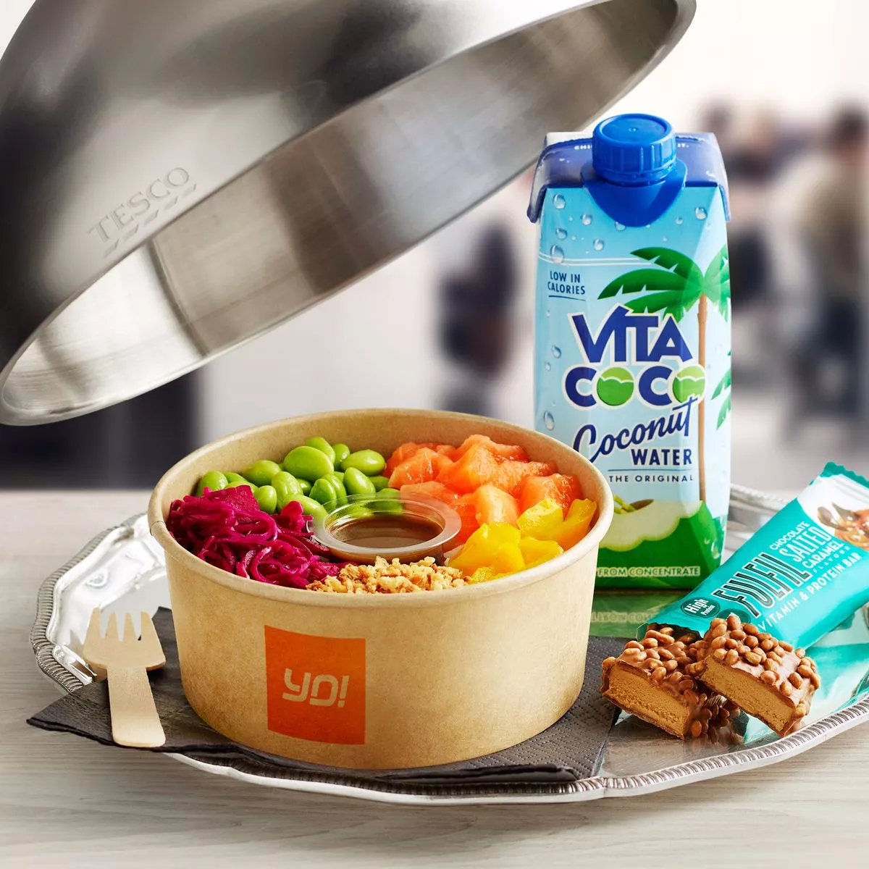
Partnerships are allowing for higher quality propositions
86%
Think good quality has a price
73%
Are happy to pay more for higher quality
Source: Lumina Intelligence Eating & Drinking Out Panel 52WE 29.10.2023
Notes:
Tesco has created a tiered meal deal offering with the launch of its £5 premium deal. This gives shoppers the option to level up their lunch while retaining entry level offers.
The inclusion of premium add-ons and tiered price points provide operators with the opportunity to upsell, driving trip spend, whilst maintaining strong value for money credentials.

Slide 16
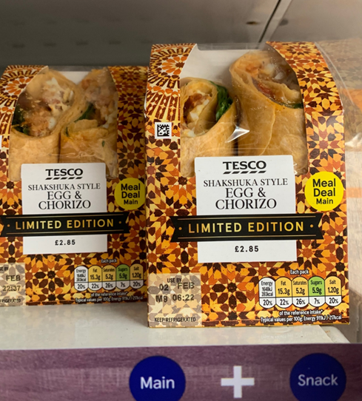
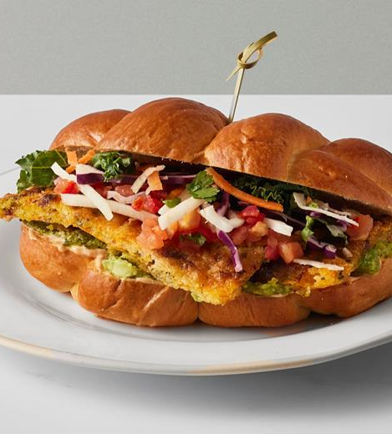
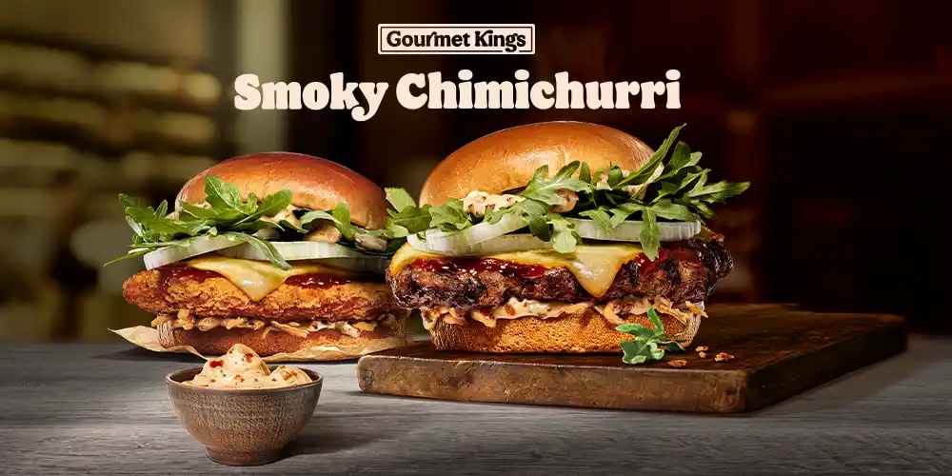
LTOs & premium NPD boosts novelty
Source: Tesco Express, Burger King, Gail’s
Notes:
Limited edition and premium products are focusing on elevated and innovative flavour combinations, generating hype and driving footfall and incremental sales.
Burger King’s ‘gourmet kings’ range aims to elevate the fast-food experience.
Crispy Squash & Sage Challah, Gail’s (£7.50)

Slide 17
Multiple formats will drive an additional 1,000 sites per year
UK food to go market outlet numbers, net outlet growth and percentage growth, 2022-2027F
+857 | +1,312 | +1,122 | +1,055 | +1,044 | +1,062
150,349 | 151,661 | 152,783 | 153,837 | 154,881 | 155,944
Source: Lumina Intelligence Market Sizing Insight & Analysis, January 2024
Notes:
Outlet growth in channels including coffee shops, bakery & sandwich and travel segments is forecast to accelerate from 2024F-2027F versus 2019-2024F, with investment in transport hubs, commuter belt towns and high streets offering opportunities for formats including kiosk-style operations and larger drive-thru sites.

Slide 18
High street and city centre growth signals return to pre-pandemic lifestyles
Share of food to go market occasions by area
Source: Lumina Intelligence Eating and Drinking Out Panel, data collected 52WE 22.01.2023 and 21.01.2024
Notes:
Retail/industrial park saw share of occasions contract as consumer volumes returned to high streets and city centres. The shift back towards city centres is expected to be felt more strongly in 2024.

Slide 19
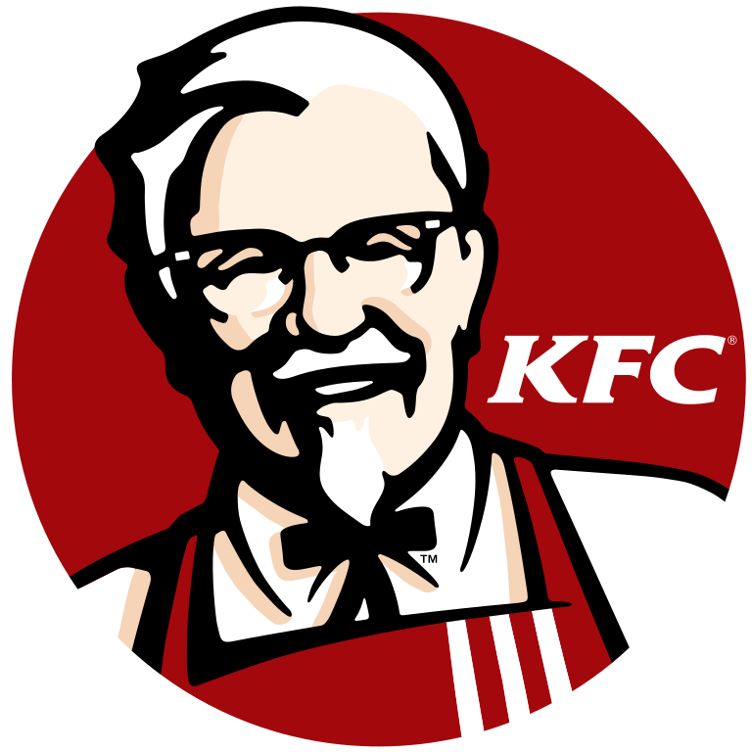
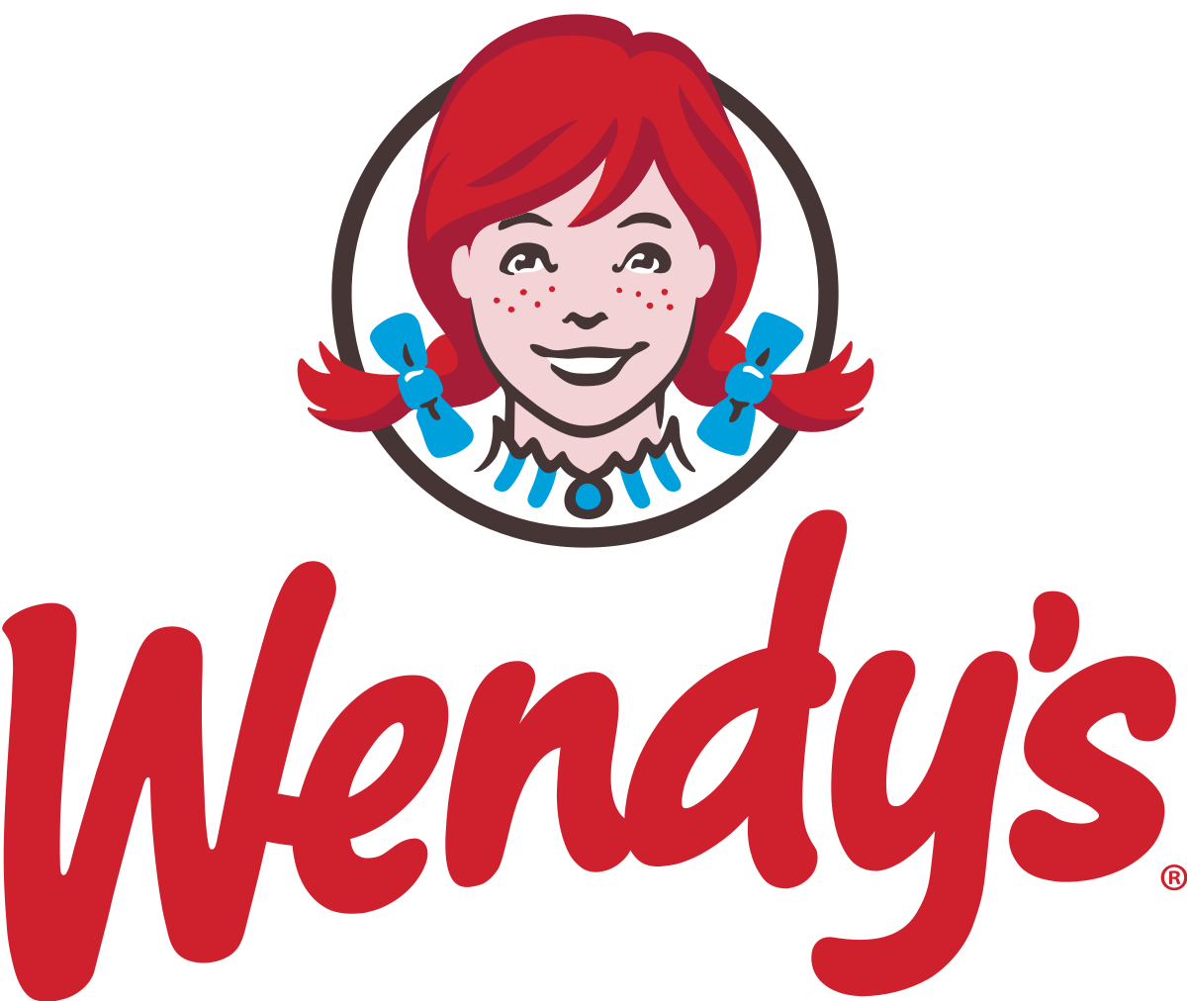
Operators seize opportunities in travel hubs
Source: Lumina Intelligence February 2024
Notes:
The past year has seen a resurgence in both domestic and international travel, as well as a return to more traditional commuting patterns.
This resurgence is driving increased foot traffic to travel hubs, making them attractive locations for operators.
Drive-thrus present a cost-effective opportunity for brands to expand into white space, boost accessibility and generate greater transaction volumes. Lumina expects expansion in this space to accelerate in the coming year.

Slide 20
Transport investment will bring opportunities for food to go operators
Network Rail announced £43.1bn of funding plans for investment into UK railway infrastructure from 2024-2029*.
Source: Network Rail, 2024
Notes:
Investment in transport hubs will bring opportunities for food to go operators
Investment will fuel projects including station and rail upgrades and new lines and stations.
Food to go specialist giants including Greggs and Caffè Nero have been prioritising openings in newly reinvigorated travel hubs including London’s Liverpool Street Station following the launch and opening of the long-awaited Elizabeth Line.
Tortilla is adding a further four travel hub sites with franchisee SSP in 2024 with the format seen as a key growth driver for the brand.

Slide 21
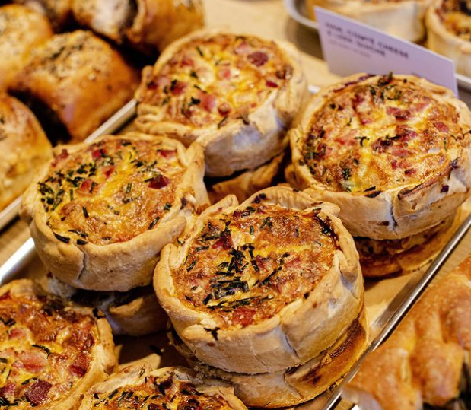
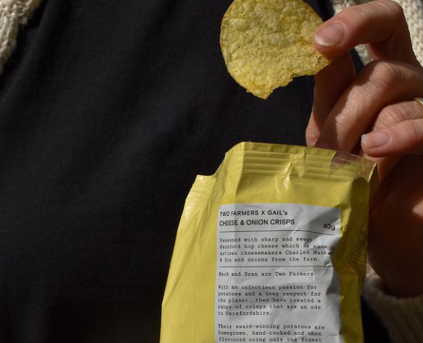
Sustainability is a business priority
Gail’s Bakery – Finalist in the Sustainability category for MCA Hospitality Awards 2024
Source: Lumina Intelligence Top of Mind Business Leaders Survey, August 2023, MCA, February 2024
Notes:
Gail’s Bakery has a three-pronged approach to sustainability, looking to have a positive impact on the environment in three ways – in its supply chain, in-house operations and within the communities it operates. Key examples of sustainable practises throughout the company include the brand’s support of small producers who practise regenerative farming, it is working with Wildfarmed – a company that is aiming to restore and diversify natural habitats. The brand remains flexible in offering, for example putting crisps on the menu for the first time in 18 years to use a suppliers’ glut of potatoes.

Slide 22
Five key trends shaping food to go
Growth is expected to accelerate, at +2.8%
Partnerships are driving spend and premiumisation
FTG consumers are more health-led leading to nuanced healthier eating
Operators are expanding with multiple formats
Digital innovation is allowing operators to cater to needs
Sustainability is a business priority

Slide 23
Scan QR code for slides!

Slide 24
Thank you for listening
Get in touch
Katie Gallagher
Insight Lead
Katie.gallagher@lumina-intelligence.com

